Slide 1

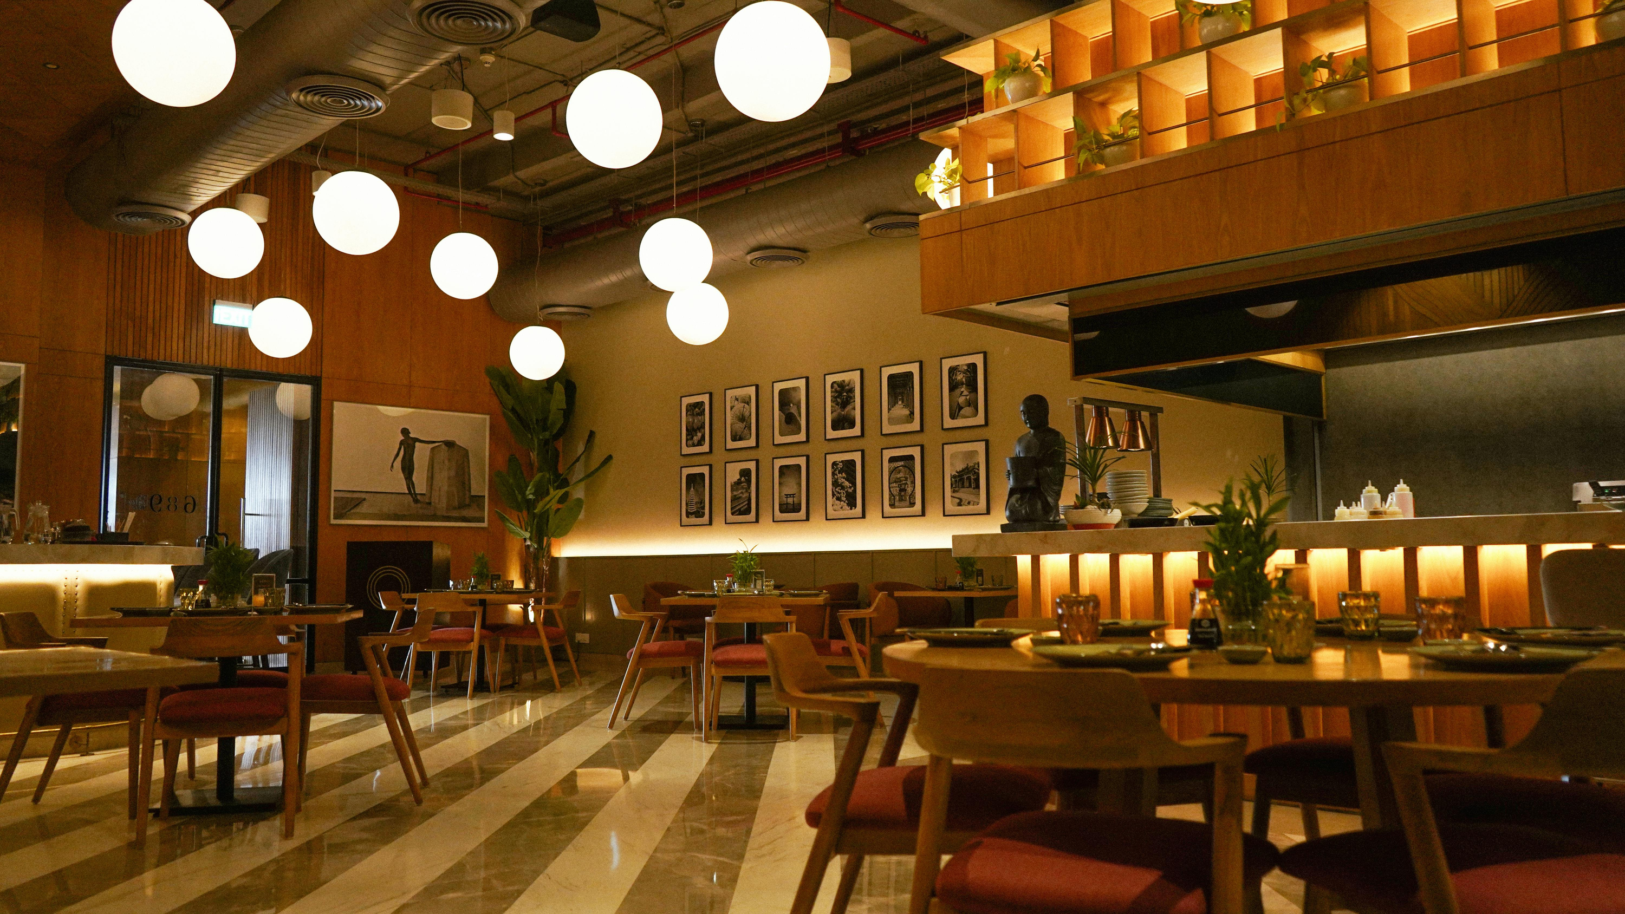







HotByte:Online Food Ordering System
A Full Stack Web Application (Angular + Spring Boot + MySQL)
by Sanchita Devkar

Slide 2




Why HotByte?
Challenges in Order Management
Traditional restaurants lacked robust online ordering.
Customers demanded quick, digital, and personalized experience.
Needed a central system for users, restaurants, and admins.
HotByte solves this by offering a modern, secure, full-stack web app.

Slide 3

Role-based portals for User, Restaurant, and Admin.
Enable secure registration/login via JWT.
Allow users to browse menu, place orders, and track delivery.
Project Objectives
Let restaurants manage menus, discounts, and orders.
Admins can monitor and manage users, restaurants, and menus.
Goals of the HotByte System

Slide 4





HotByte Technology Stack
Frontend: Angular, Bootstrap, HTML/CSS
Backend: Java, Spring Boot
Database: MySQL
Security: JWT (JSON Web Tokens)
Tools: Postman, MySQL Workbench, STS, VS Code, Swagger

Slide 5


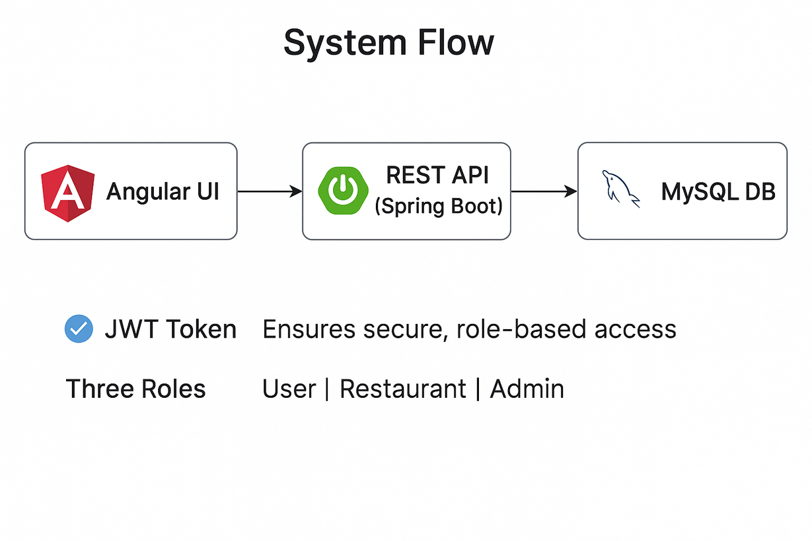
System Flow
Angular UI → REST API (Spring Boot) → MySQL DB
JWT Token → Ensures secure, role-based access
Three Roles: User | Restaurant | Admin

Slide 6
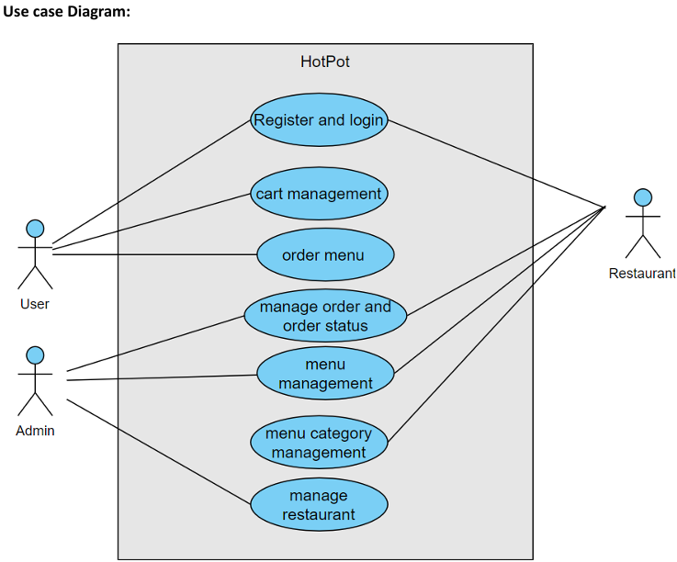

Key Use Cases in HotByte
User
Actor-Based Functionality
Register
Login
Browse Menu
Cart
Checkout
Track Orders
Restaurant
Login
Add/Edit/Delete Menus
View Orders
Restaurant Operations
Manage Users
Menus
Restaurants

Slide 7


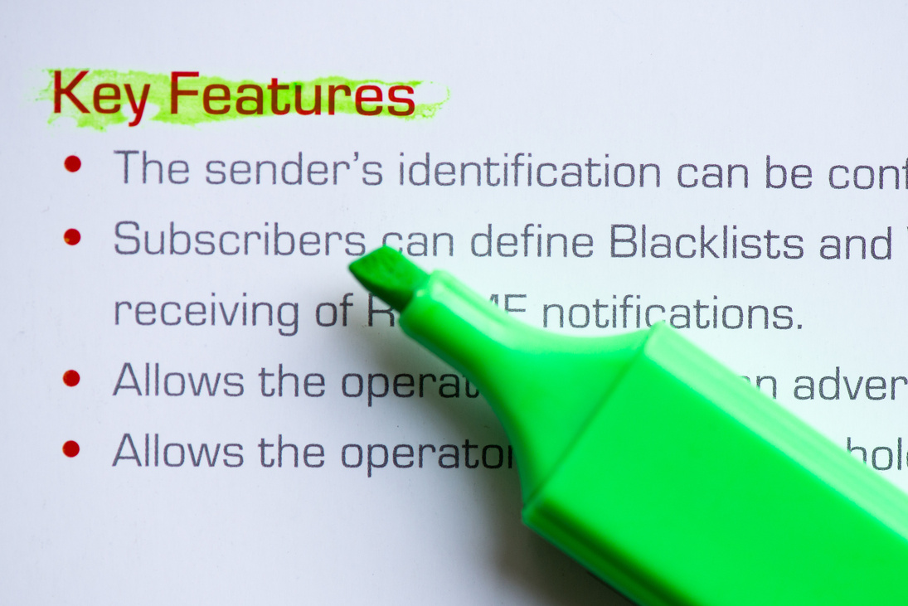

User Features
Register/Login securely with JWT
Browse categorized menu (veg/non-veg, burger, pizza, etc.)
Search, filter, and view detailed dish info
Add to cart, update quantities
Enter shipping address, proceed to payment
View order history and status

Slide 8

Restaurant Features
Login securely with role authentication
Add/Edit/Delete menu items with full details:
Name, Description, Category, Taste, Nutrition
Mark dishes as out of stock
View and process incoming orders
Access order history dashboard

Slide 9

Admin Controls
Login with Admin role
Add/Delete Restaurants and Users
View/manage all menus, orders, and categories
Toggle account status (active/blocked)
Maintain platform-wide security and consistency

Slide 10
Backend DB Structure
Main Tables:
Relations
users (userId, role, contact, etc.)
restaurants (restaurantId, name, etc.)
menus (menuId, category, price, etc.)
orders, order_items, cart_items
One restaurant → many menus
One user → many orders
One order → many items

Slide 11

Authentication & Authorization
User logs in → Server returns token
Token includes role, userId, expiry
Token sent in each API call via headers
Spring Security verifies token and grants access
Unauthorized access returns 401/403
Logout clears token from localStorage

Slide 12


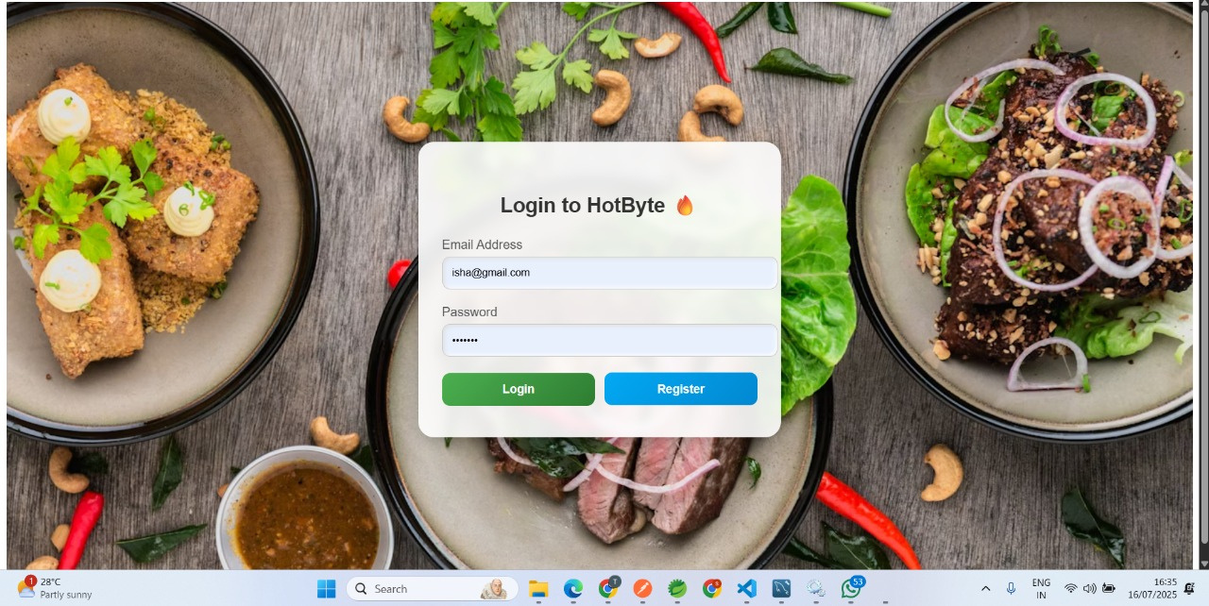


Application Screens

Slide 13
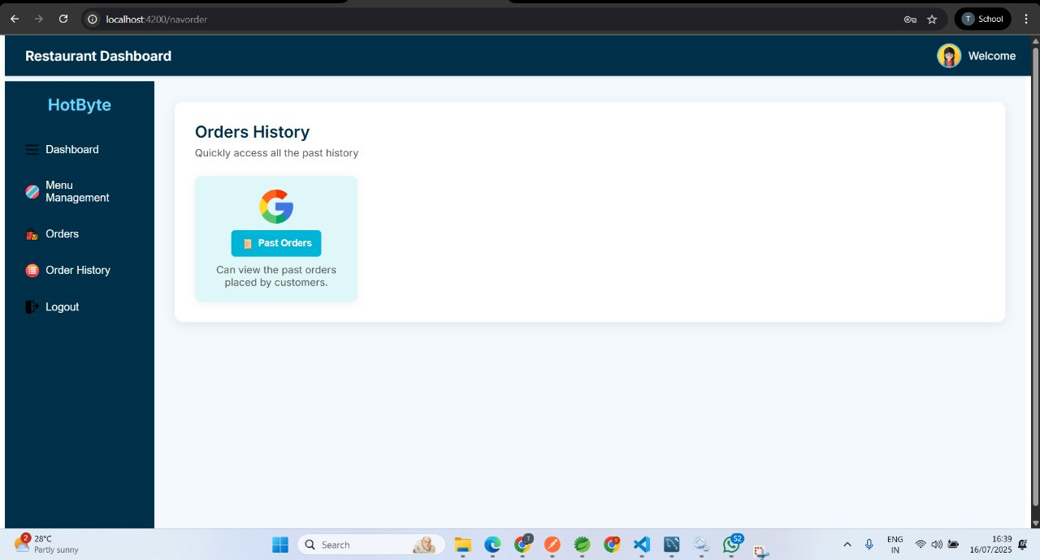
Application Screens

Slide 14
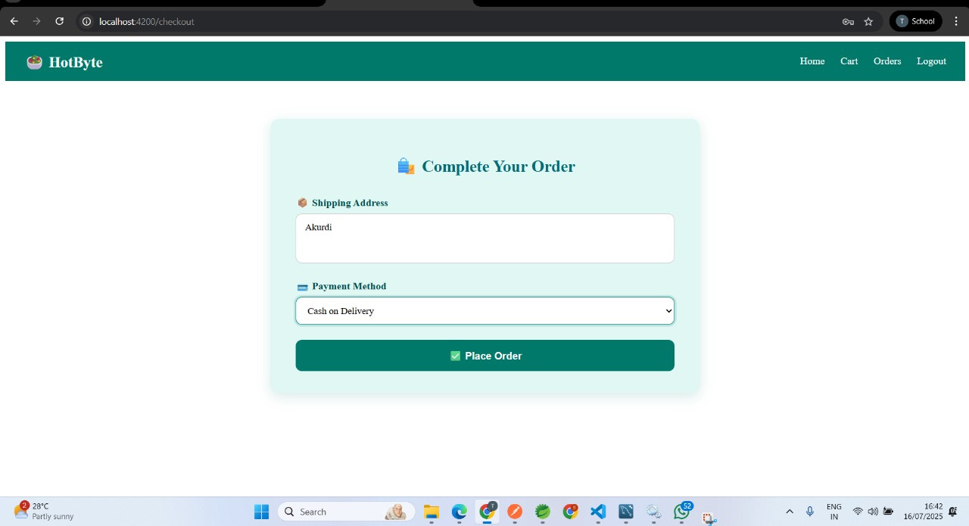
Application Screens

Slide 15




Sample API Flow
Example: Place Order
User clicks "Checkout" → API /user/checkout
Backend validates cart, saves order
Order confirmation email sent
Status updated: Ordered → Processing → Delivered
Similar APIs used for:
Menu fetch
Login/Register
Admin management

Slide 16

Issues Faced & What’s Next
Challenges
JWT decoding and role handling in Spring Security
Mapping nested restaurant/menu objects
CORS issues during dev
Styling & responsive layout
Next Steps:
Add real payment gateway (Razorpay)
Email/SMS notification for every order
Add CI/CD, Docker, AWS deployment
Add unit test coverage and Swagger Docs

Slide 17




Final Takeaway
HotByte is a fully working multi-role food ordering system
Implemented complete workflow: registration → order → delivery
Learned key skills in Angular, Spring Boot, REST APIs, JWT, MySQL
Ready for real-world deployment and further improvements

